Slide 1
9.6: Testing Communities Presentation Plan
Sahith Bhamidipati

Slide 2
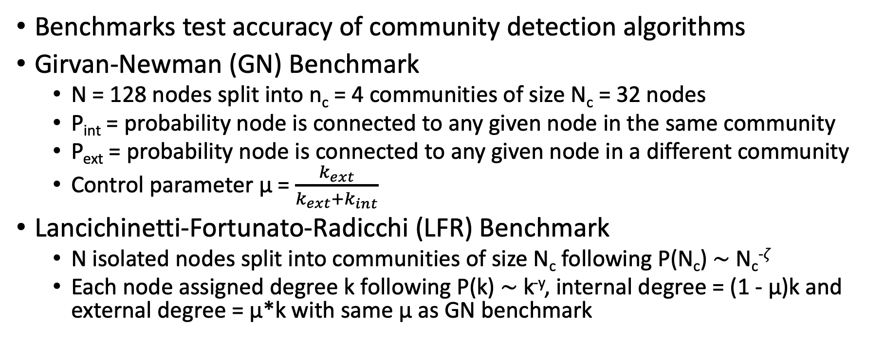
Testing benchmarks
Benchmarks test accuracy of community detection algorithms
Girvan-Newman (GN) Benchmark
  N = 128 nodes split into n_{c} = 4 communities of size N_{c} = 32 nodes
  P_{int} = probability node is connected to any given node in the same community
  P_{ext} = probability node is connected to any given node in a different community
  Control parameter μ = $\frac{k_{ext}}{k_{ext}+k_{int}}$
Lancichinetti-Fortunato-Radicchi (LFR) Benchmark
  N isolated nodes split into communities of size N_{c} following P(N_{c}) ∼ N_{c}^{-𝜁}
  Each node assigned degree k following P(k) ∼ k^{-y}, internal degree = (1 - μ)k and external degree = μ*k with same μ as GN benchmark

Slide 3
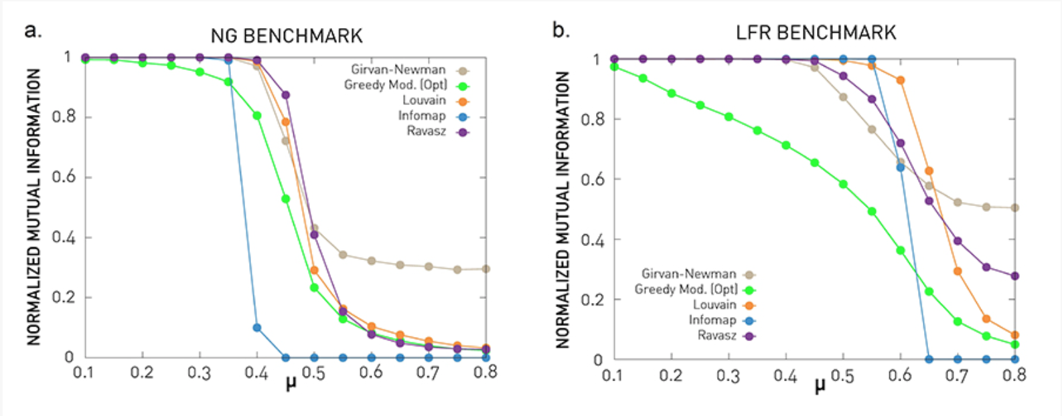
Tests on Community Detection Algorithms

Slide 4
Obstacles
For GN benchmark:
  GN random graph has nodes with similar degrees and communities with similar sizes
  Doesn’t usually translate to real graphs
For both, issues with algorithms based on clique percolating or link clustering
Specific definition of communities

Slide 5
Focus of Presentation
Methods of measuring accuracy
Best community detection algorithm
Best benchmark for testing
Best parameters for benchmarks
Related papers

